Slide 1




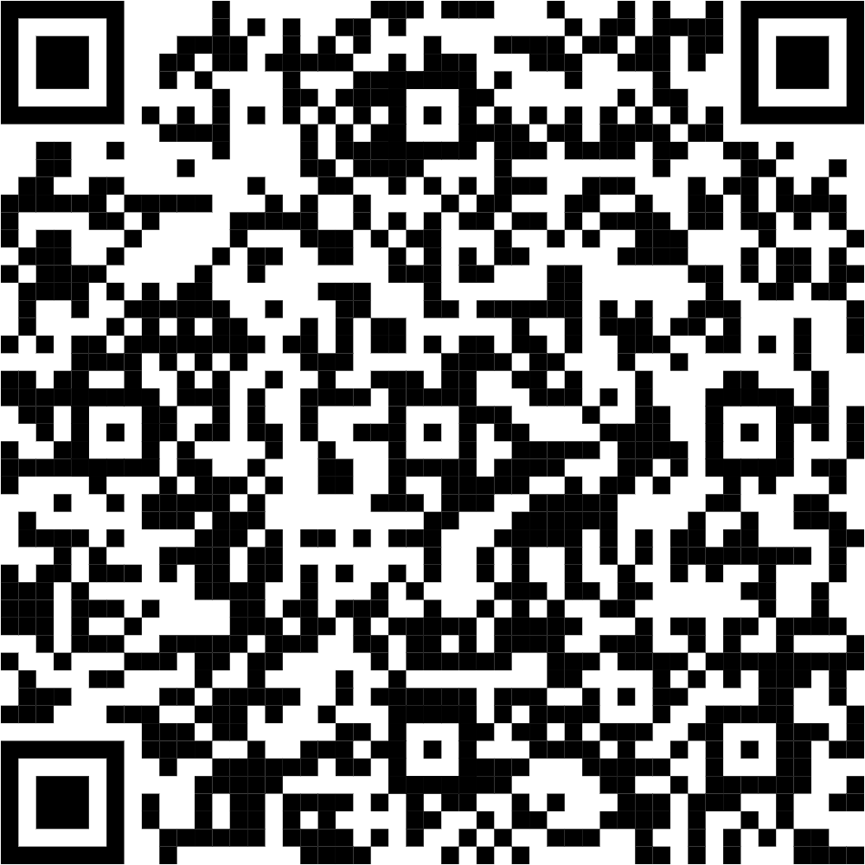
Group 27: Hotel Booking Overview
Tony Xie | Ananya Srinivas | Yamuna G C | Adrian Mato | Nakul Sidiginamola
Target Audience
Data Story
Hotel Managers
Ever wondered why hotel bookings spike or guests cancel at the last minute?
We dug into 119,000+ bookings to find out what drives these trends.
From pricing to planning, our story gives hotels the insights they need to thrive.
Main Task
Reveal booking trends and guest behaviors to help hotel managers boost revenue, reduce cancellations, and plan for peak periods
“Slip on your sharp hotel manager’s blazer, For the next few minutes, you’re the decision-maker for high-stakes decisions from maximizing hotel revenue to reducing cancellations, and planning for peak periods.”

Slide 2
Group 27: Hotel Booking Overview
Tony Xie
Ananya Srinivas
Yamuna G C
Adrian Mato
Nakul Sidiginamola
Target Audience
Data Story
Hotel Managers
Ever wondered why hotel bookings spike or guests cancel at the last minute?
We dug into 119,000+ bookings to find out what drives these trends.
From pricing to planning, our story gives hotels the insights they need to thrive.
Main Task
Reveal booking trends and guest behaviors to help hotel managers boost revenue, reduce cancellations, and plan for peak periods
“Slip on your sharp hotel manager’s blazer, For the next few minutes, you’re the decision-maker for high-stakes decisions from maximizing hotel revenue to reducing cancellations, and planning for peak periods.”

Slide 3


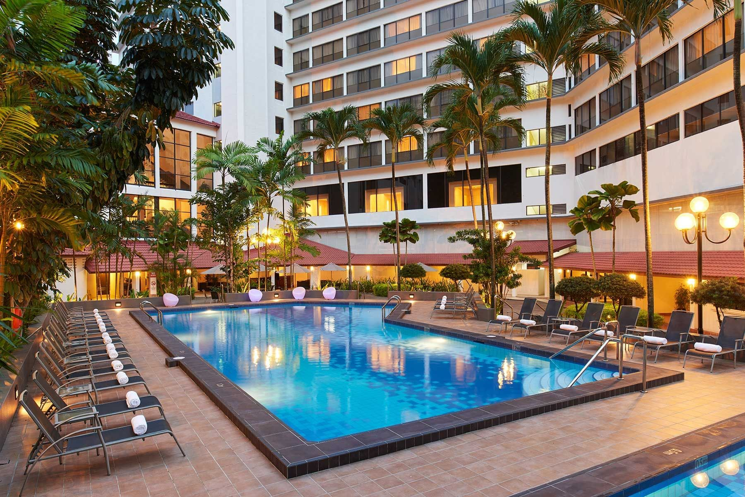




Hotel Booking Overview
Group 27
Insights from 119,000+ hotel bookings
Target Audience
Welcome, Hotel Managers!
Hotel Managers
Data Story
Hotel bookings spike, and cancellations happen unexpectedly. By analyzing 119,000+ bookings, we uncovered key trends in pricing, guest behavior, and seasonality—providing insights that help hotels thrive.
Main Task
Reveal booking trends and guest behaviors to help hotel managers boost revenue, reduce cancellations, and plan for peak periods
Image for illustration only
Source: York Hotel(Singapore)
“Slip on your sharp hotel manager’s blazer, For the next few minutes, you’re the decision-maker for high-stakes decisions from maximizing hotel revenue to reducing cancellations, and planning for peak periods.”
Scan to explore the dashboard
Tony Xie | Ananya Srinivas | Yamuna G C | Adrian Mato | Nakul Sidiginamola

Slide 4
Hotel Booking Overview
Group 27
Insights from 119,000+ hotel bookings
Target Audience
Welcome, Hotel Managers!
Hotel Managers
Data Story
Hotel bookings spike, and cancellations happen unexpectedly. By analyzing 119,000+ bookings, we uncovered key trends in pricing, guest behavior, and seasonality—providing insights that help hotels thrive.
Main Task
Reveal booking trends and guest behaviors to help hotel managers boost revenue, reduce cancellations, and plan for peak periods
Image for illustration only
Source: York Hotel(Singapore)
“Slip on your sharp hotel manager’s blazer, For the next few minutes, you’re the decision-maker for high-stakes decisions from maximizing hotel revenue to reducing cancellations, and planning for peak periods.”
Scan to explore the dashboard
Tony Xie | Ananya Srinivas | Yamuna G C | Adrian Mato | Nakul Sidiginamola

Slide 5
Title heading
Place long title here:
Ligenimus pe vento molor si od quodio.
Nam dollaut qui as remporest, sitatem
renienitatat et at que sequosti ne.

